Slide 1

Department of Computer Science and Engineering Academic Year (ODD 2024-25) 22CSE58 - Mini Project using Python Blog Website
Reviewer
Ms. - Shreenagamanjula Rani
Sr. Assistant Professor
Dept. of CSE, NHCE
Team Members
1NH22CS195- Saurabh Chandra
1NH22CS187- Sahil Kumar

Slide 2
Contents
Objectives
Abstract
Problem Definition
Requirement Specification
Design
Methodology
Implementation
Result
Conclusion

Slide 3
Objectives
The objective of this project is to develop a fully functional blog website using Python and the Django framework. The website will provide a platform for users to read and interact with blog posts. It will feature a clean and responsive interface, robust user authentication, and efficient content management, empowering both content creators and readers.

Slide 4
Abstract
This project develops a blog website using Python and the Django framework, providing a platform for users to interact with blog posts. The website is designed with a responsive, mobile-friendly interface using HTML, CSS, and JavaScript. Django’s built-in admin panel allows easy content management. The site is optimized for performance with caching and database query optimization, making it scalable and efficient for growing user bases.

Slide 5
Problem Definition
The problem is to create an efficient and user-friendly blog website where users can interact with existing blog content. Many individuals want to engage with blog posts, comment on them, and explore content in a structured way, but they often face platforms that are difficult to use or lack customization.
This project addresses this issue by building a blog website using Python and Django, where users can register, log in, comment on posts, and search for content based on categories. The platform will also include an admin panel to manage user interactions and comments effectively. It will be designed with a responsive, mobile-friendly interface, ensuring accessibility across different devices.
The goal is to provide a simple, scalable platform that allows users to interact with existing blog posts, participate in discussions, and navigate content easily, creating an engaging and intuitive user experience.

Slide 6
Requirement Specification
Functional Requirements:
User Registration & Login
Blog Post Interaction
Search & Filtering
Admin Panel
User Profile Management
Comment Moderation

Slide 7
Requirement Specification
Non-Functional Requirements:
Performance
Usability
Scalability
Security
Compatibility
Maintainability

Slide 8
Requirement Specification
Hardware Requirements:
Processor: 2.0 GHz dual-core (min), multi-core (recommended)
RAM: 4 GB (min), 8 GB (recommended)
Storage: 20 GB (min), 50 GB (recommended)
Network: 2 Mbps internet speed (min)
Display: 1366 x 768 resolution (min)

Slide 9
Requirement Specification
Software Requirements:
OS: Windows 10/11, macOS, or Linux (Ubuntu recommended)
Browser: Chrome, Firefox, Safari, or Edge
Language: Python 3.x
Framework: Django 3.x or later
Database: SQLite (default), PostgreSQL/MySQL (for production)
Editor/IDE: VS Code, PyCharm, Sublime Text

Slide 10
Design
1. Home Page
Header: Logo, Nav (Home, About, Categories, Login/Register), Search
Main Content: Blog post cards (title, excerpt, author, "Read More")
Footer: Links (About, Privacy, Terms)
2. Blog Post Page
Header: Same as Home
Main Content: Post title, content, comments section
Footer: Same as Home

Slide 11
Design
3. User Profile
Content: Avatar, profile info, user posts, log out
Footer: Same as Home
4. Admin Panel
Nav: Dashboard, Posts, Users, Comments
Content: Post and user management
Footer: Admin links

Slide 12
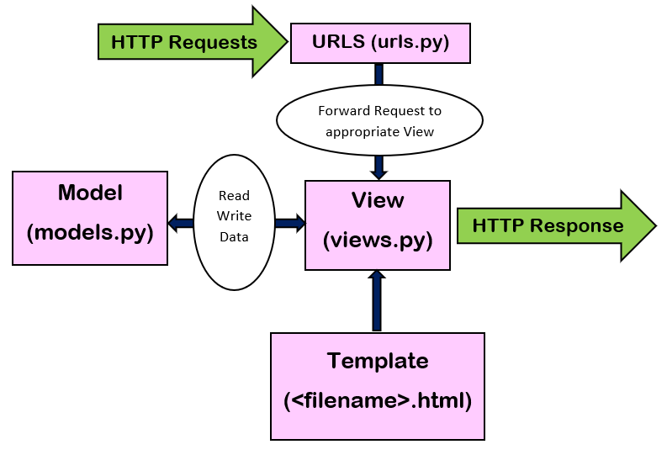
Design

Slide 13
Methodology
Requirements Gathering
Identify project goals, features, and user needs.
System Design
Plan architecture, database schema, and UI layouts.
Technology Selection
Backend: Python, Django
Frontend: HTML, CSS, JS
Database: SQLite/PostgreSQL

Slide 14
Methodology
Development
Implement user authentication, blog CRUD, comments, search/filter, and admin panel.
Testing
Conduct unit, integration, and user acceptance testing.
Deployment
Deploy to platforms like Heroku, AWS, or DigitalOcean.

Slide 15
Implementation
The implementation of the blog website involves setting up a Django project with user authentication, allowing users to register, log in, and manage profiles. Blog posts are displayed on the site, and a comments section enables user interaction with posts. A search feature and category filtering are included for better content discovery. The frontend is built using HTML, CSS, and JavaScript to ensure responsiveness across devices. Django's admin panel facilitates the management of users, posts, and comments. The database (SQLite or PostgreSQL) stores content, and the site is tested before deployment on platforms like Heroku or AWS.

Slide 16
Result
The blog website successfully allows users to register, log in, and interact with blog posts through comments. The platform features a responsive design, providing an optimal user experience across devices. Users can easily search for posts and filter content by categories. The Django admin panel allows administrators to efficiently manage users, posts, and comments. The database (SQLite for development, PostgreSQL for production) stores all necessary data. The site is fully functional, with tested features for security and performance. After deployment on platforms like Heroku or AWS, the blog website is accessible, scalable, and user-friendly for both readers and admins.

Slide 17
Conclusion
In conclusion, the blog website built using Python and Django offers a secure, scalable, and user-friendly platform for both content creators and readers. By implementing features like user authentication, comment sections, and content search, it provides an interactive experience. The integration of Django's admin panel ensures efficient management of users and posts. The website's responsive design makes it accessible across various devices, while the use of a reliable database ensures data integrity. With successful testing and deployment, the platform is ready for real-world use, offering a seamless blogging experience for users and administrators alike.

Slide 18


